Slide 1


CANARA ENGINEERING COLLEGE
Presentation on
RESPIRATORY DISORDER DETECTOR
Presented By : 1. Raveena Naik 2. Vinutha K G 3. Swati Moger 4. Sudarshan
Guided By : Mr. Sandeep Prabhu M
Department of Electronics & Communication Engineering

Slide 2
01
INTRODUCTION
02
MOTIVATION & OBJECTIVE
03
METHODOLOGY
04
IMPLEMENTATION
CONTENTS
05
RESULTS
06
FUTURE WORK
07
CONCLUSION

Slide 3
INTRODUCTION
Respiratory diseases are a major public health concern worldwide
Early detection and accurate diagnosis of respiratory diseases are critical for effective treatment and management
Convolutional Neural Networks (CNNs) have shown promising results in various medical applications, including respiratory disease detection
This presentation aims to introduce the concept of using CNNs for respiratory disease detection and discuss the methodology used

Slide 4
MOTIVATION & OBJECTIVE
Respiratory diseases are a leading cause of morbidity and mortality worldwide
The current methods for respiratory disease diagnosis, such as pulmonary function tests and radiography, have limitations in terms of sensitivity and specificity
The objective of this study is to develop a CNN-based system for accurate and early detection of respiratory diseases

Slide 5
LITERATURE REVIEW
CNN-MoE based framework for classification of respiratory anomalies and lung disease detection
This paper presents a deep learning framework for analyzing respiratory anomalies and detecting lung diseases from sound recordings
The proposed system outperforms existing methods and can be implemented in real-time systems

Slide 6
2. Lung disease detection using deep learning
This paper is a research proposal for using deep learning to detect lung diseases
The proposed system aims to address the increasing pressure on health due to environmental and lifestyle changes, with a focus on chronic obstructive pulmonary disease (COPD) and asthma.

Slide 7
METHODOLOGY
The audio signals are preprocessed to remove noise and irrelevant features using signal processing techniques
The CNN model is trained using the preprocessed audio signals, and the hyperparameters are tuned to optimize the model performance
The trained model is validated using a separate test dataset to evaluate its performance in detecting respiratory diseases
The final model is deployed and tested on new audio signals to assess its real-world performance

Slide 8
Data Acquisition
Gather respiratory sound data using a stethoscope or other recording devices
01
Data Processing
Testing and Deployment
Clean and prepare the data for training by filtering out noise, segmenting the recordings, and extracting relevant features
Deploy the model on a new dataset to evaluate its performance in real-world scenarios. Evaluate the model's performance using various evaluation metrics
02
05
Model Training
Model Validation & Evaluation
03
Develop a deep learning model using convolutional neural networks (CNN) to classify respiratory sounds into different disease categories
04
Test the performance of the model using various metrics such as accuracy, sensitivity, and specificity on a validation dataset. Refine the model as needed

Slide 9

IMPLEMENTATION
BLOCK DIAGRAM
Capture respiratory signals
Filter ,
Pre amplifier
& Save the file
Classification using ML method
Software Implementation
Disorder detection

Slide 10
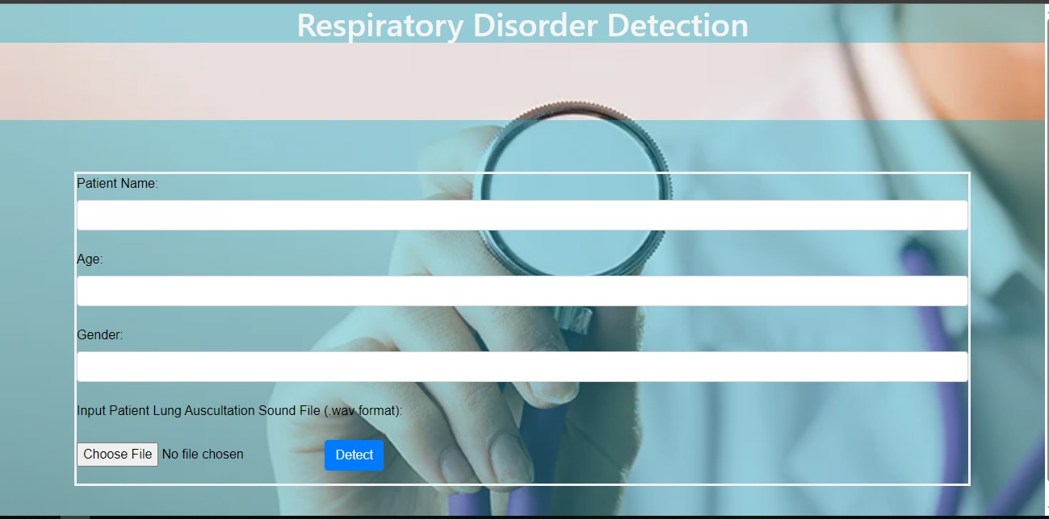
RESULTS

Slide 11
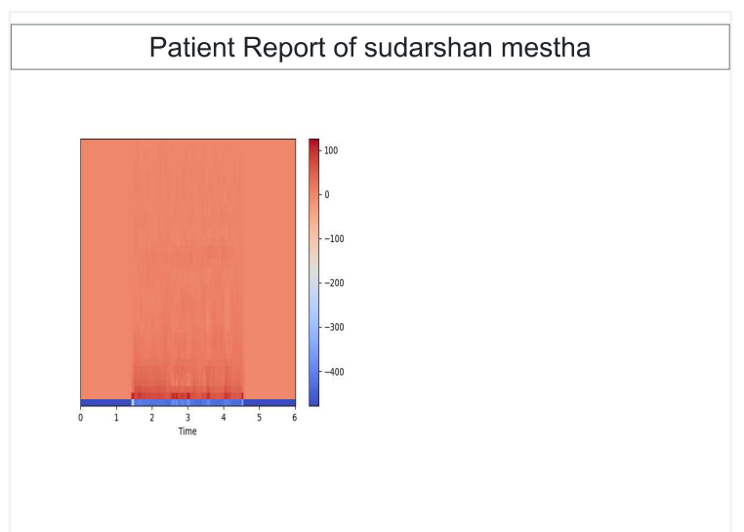
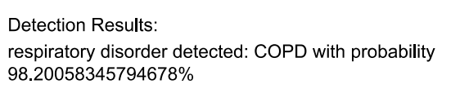

Slide 12
FUTURE WORK
Increasing the dataset size to improve the model's performance
Exploring transfer learning techniques to reduce the training time and improve the accuracy
Integrating the system with wearable devices for continuous monitoring of respiratory health
Collaborating with healthcare professionals to integrate the system into clinical practice

Slide 13
CONCLUSION
The use of CNNs for respiratory disease detection shows promising results in terms of accuracy and early detection
The methodology presented in this study can be used as a framework for developing a reliable and efficient respiratory disease detection system
The integration of such a system into clinical practice can potentially improve the diagnosis and treatment of respiratory diseases, leading to better patient outcomes

Slide 14
REFERENCE
[1] B. M. Rocha et al., “An open access database for the evaluation of res_x0002_piratory sound classification algorithms,” Physiological measurement,
vol. 40, no. 3, p. 035001, 2019
[2] H. Zhang, I. McLoughlin, and Y. Song, “Robust sound event recog_x0002_nition using convolutional neural networks,” in Proc. ICASSP, 2015,
pp. 559–563
[3] R. J. Riella, P. Nohama, R. F. Borges, and A. L. Stelle, “Automatic
wheezing recognition in recorded lung sounds,” in Proc. EMBC, 2003,
pp. 2535–2538

Slide 15
THANK YOU

